Slide 1
DG Interns Hub
Cybersecurity Internship
Week 6 Assignment Report
Submitted by: Ajith Kumar
Batch / Intern ID: DG/AUGUST/CYBER/031
Date: 30-09-2026

Slide 2
What is VAPT?
VAPT stands for Vulnerability Assessment and Penetration Testing. It is a security process used to find weaknesses in systems, websites, and applications and check whether attackers can exploit them.
VAPT combines finding security vulnerabilities with safely testing those vulnerabilities. It helps organizations identify and fix security problems before real attackers can use them.
Importance of Web-Security Testing
Web-security testing helps protect websites and applications from hackers, data theft, unauthorized access, and other attacks. It also helps organizations fix security issues before they cause damage.

Slide 3
OWASP Top 10
OWASP Top 10 is a widely used awareness guide that highlights the 10 most critical web application security risks.
Broken Access Control – Users can access resources they shouldn’t.
Cryptographic Failures – Sensitive data is poorly protected.
Injection – Malicious input alters application commands or queries.
Insecure Design – Security is missing in the application design.
Security Misconfiguration – Incorrect or unsafe security settings.
Vulnerable Components – Using outdated or insecure libraries/software.
Authentication Failures – Weak login and identity controls.
Software & Data Integrity Failures – Untrusted updates, code, or data.
Logging & Monitoring Failures – Security incidents are not detected effectively.
Server-Side Request Forgery (SSRF) – Attackers manipulate the server into making unintended requests.
Key message: OWASP Top 10 helps developers and security teams identify, prevent, and reduce common web application vulnerabilities.

Slide 4
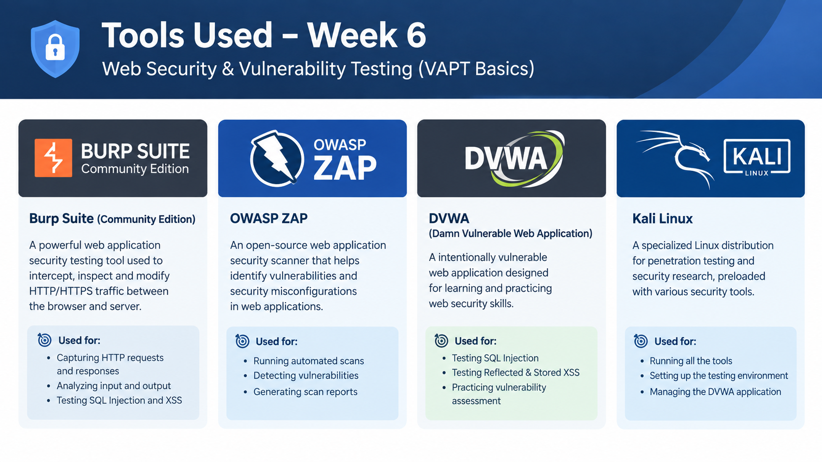
Tools Used

Slide 5
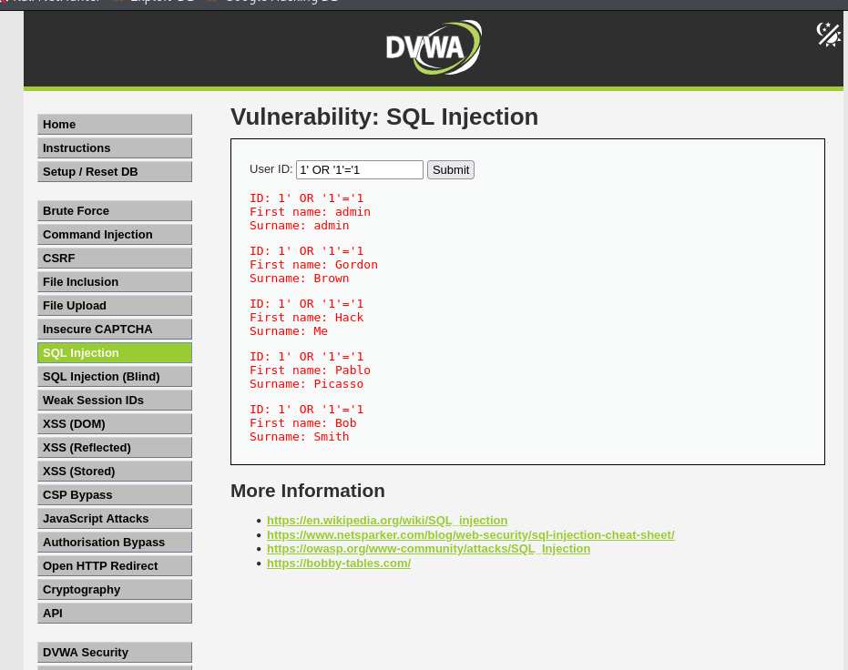
SQL Injection Testing
Open the SQL Injection module
In DVWA's left-side menu, click: SQL Injection
Test a basic SQL Injection condition
In the same local DVWA input field, enter this educational test string:
1' OR '1'='1 Click Submit.

Slide 6
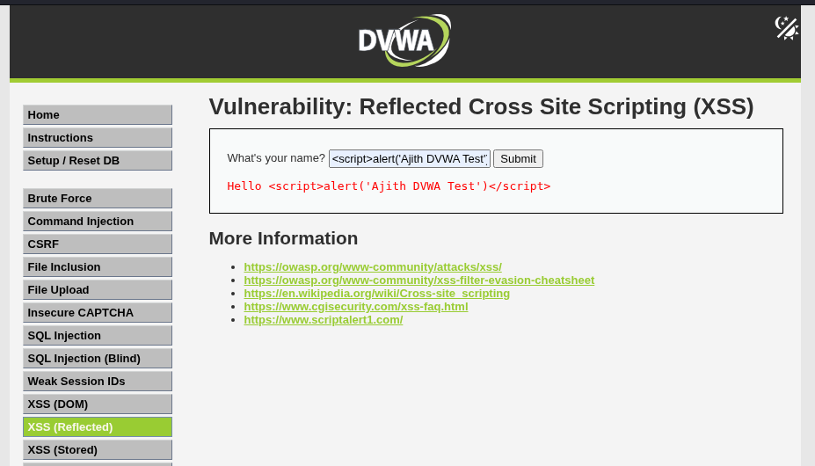
XSS Testing
Cross-Site Scripting (XSS) is a web security vulnerability where untrusted content is interpreted by a user's browser as executable script.
Types of XSS: 1. Stored XSS, 2. Reflected XSS, 3. DOM-Based XSS

Slide 7
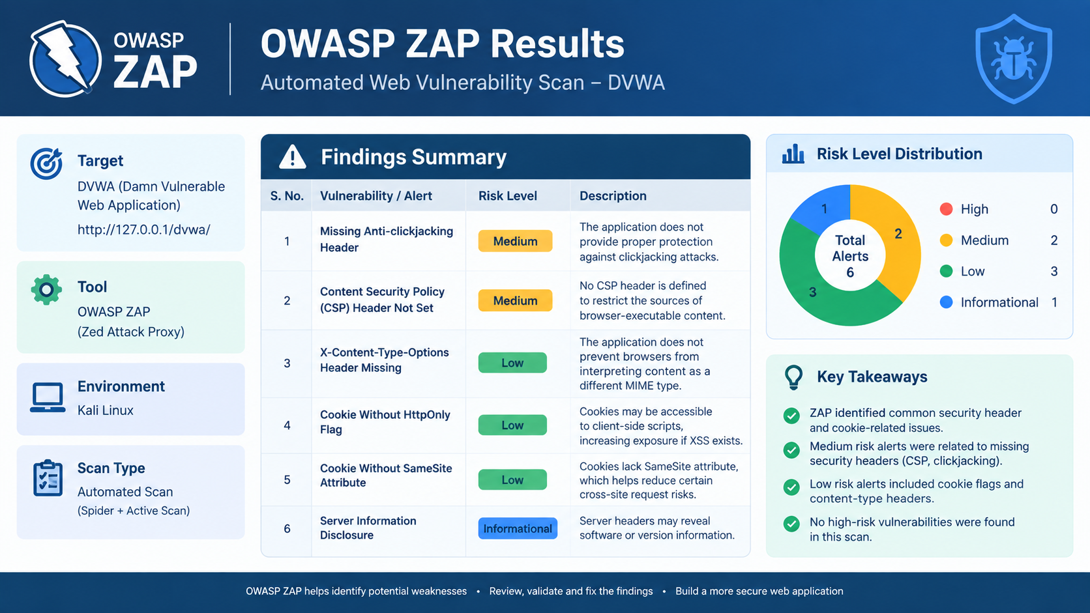
OWASP ZAP Results

Slide 8
Mitigation & Learning
Overall Mitigation Recommendations
Based on the practical testing, the following security practices are recommended for web application developers:
Secure database interaction: Use prepared statements and parameterized queries to prevent SQL Injection.
Input validation: Validate all user-supplied data on the server side.
Output encoding: Encode untrusted content before displaying it in a browser.
Secure coding practices: Avoid unsafe functions that directly execute or render user input.
Database security: Restrict database permissions to only the operations required by the application.
Security headers: Configure appropriate HTTP security headers, including Content Security Policy where applicable.
Learning outcome: Burp Suite helped me understand the communication between a web browser and a server and demonstrated how security testers analyze application behavior.

